Slide 1

Practical 1
Practical Preparation
Ethical Hacking
Diploma in CSF
Year 3 (2021/22), Semester 5

Slide 2
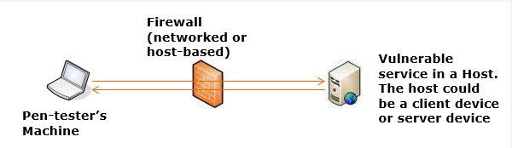
Introduction
Many systems are vulnerable to service-side exploitation due to the imperfections in the many system software that are being run as services as part of the offering by the operating system or add-on to the operating system.
Service Side Attack is also known as Server Side Attack. The attack is launched form the client to the listening server.
The main characteristics of this form of attack are there is no need for human help at the server end for the exploitation to work and the attack can be launched directly over the network.
In this practical, you will learn to penetrate into system that exhibiting one or more service side vulnerabilities.

Slide 3
Learning Objectives
At the end of this worksheet, you will be able to:
Penetrate into the target XP VM using service side attack approach and explore the files and folders in the exploited machines.

Slide 4
Important Instructions (READ)
Use your NOTEBOOK for this practical:
You need to copy the XP VM in the Desktop’s Hard-disk. Check with your tutor where to copy from.
Start both Kali Linux and Windows XP virtual machines in VMware Workstation Player.
Set network setting of both VMs to “NAT”. Record down their IP Address respectively.
Windows XP’s IP Address:
Kali Linux’s IP Address:
Ping one another to see if they are reachable, if not consult your peers or tutor.

Slide 5
Contents
Practical Tasks
Task 1 – Start Metasploit in Kali Linux and Search for MS08-076 exploit
Question P1.1
Task 2 – Use the MS87-076 Exploit and set its Options
Task 3 – Penetrate into the Target XP VM
Task 4 – Exploring the Exploited Machine using Metepreter’s commands
Task 5 – Exploring the Exploited Machine using DOS’s commands
Task 6 – Upload a file to the Remote Machine
Task 7 - Exploring other Payload available in Metasploit
Challenge

Slide 6
Task 1 – Start Metasploit and Search for MS08-076 Exploit

Slide 7
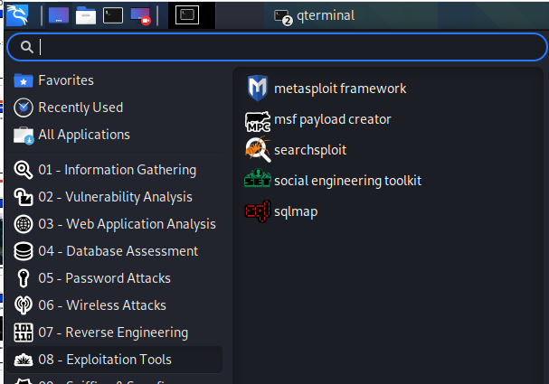
Start Metasploit and Search for MS08-076
Start [metasploit framework] in Kali Linux.

Slide 8
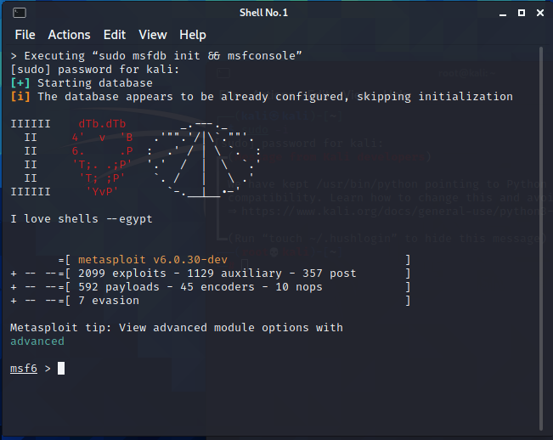
Enter “kali” as password.

Slide 9
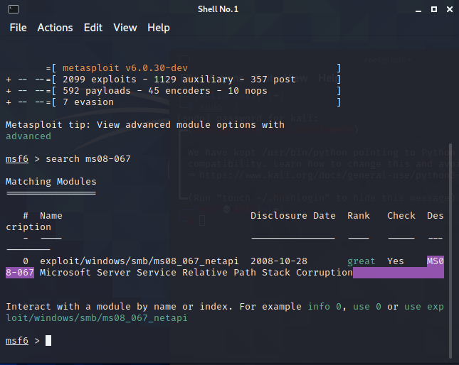
Search for MS08-076 exploit by executing the command “search ms08-067”

Slide 10
Question P1.1
Research to find out what is MS 08-067 vulnerability reported by Microsoft and what are the impacts of this vulnerability?
What is the CSV number for MS08-067 ?
(Enter your answer in a spreadsheet in your class’s team.
--- End of Task 1 ---

Slide 11
Task 2 – Use the MS87-076 Exploit and set its Options

Slide 12
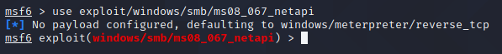
Task 2 - Use the Exploit and set its Options
Let’s first adopt the exploit for use.

Slide 13
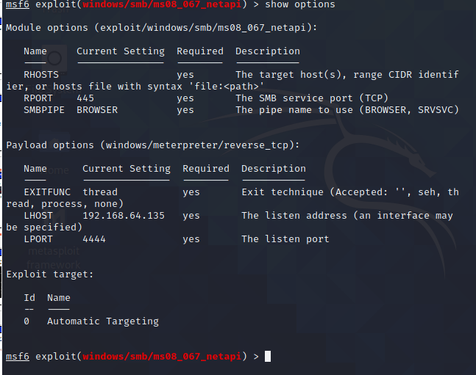
Task 2 - Use the Exploit and set its Options
Every exploit comes with different parameters that need to be set before it can be properly exploited. Type “show options” at the # prompt.

Slide 14
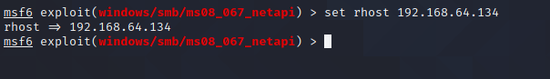
Here we need to set the IP address of the target (Windows XP VM) as be the value of RHOST. Your XP VM’s IP address maybe different from that shown in the diagram.

Slide 15
If you need to reset at any time, just go ahead and use the “set” command to reset. If you wish to get out of the exploit mode, use the “back” command. Use the “exit” command to get out of Metasploit.
Once you set the options, you are all set to exploit the target. Go to next Task.
--- End of Task 2 ---

Slide 16
Task 3 – Penetrate into the Windows XP VM

Slide 17
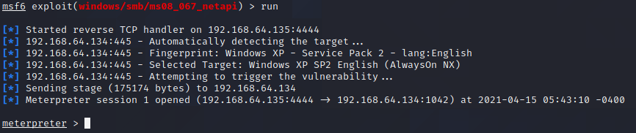
Task 4 – Penetrate into the Target
Make sure the Firewall of XP VM is turned off. To penetrate into the machine, just type the command “run/exploit”.
Wow La! You are in … Once a “meterpreter” prompt is returned, it signal that we have already successfully penetrated into the system.
--- End of Task 3 ---

Slide 18
Task 4 – Exploring the Exploited Machine using Metepreter’s commands

Slide 19
You may type “help” to see a list of commands to explore the target system.
Checkout and list the categories of command and look for the commands for exploring the directory in the remote machines.

Slide 20
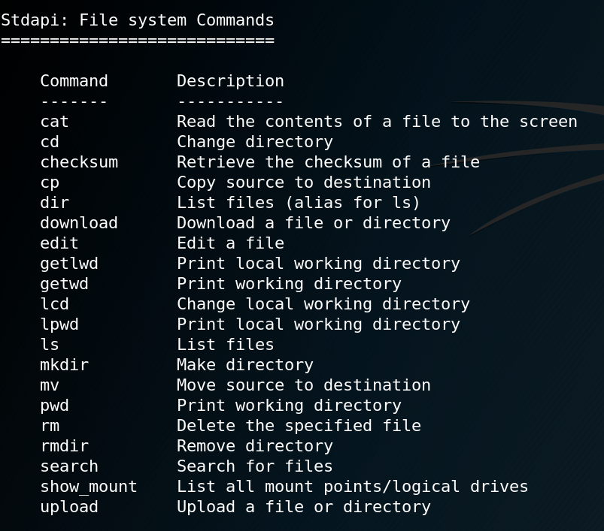

Slide 21
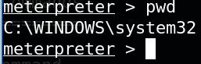
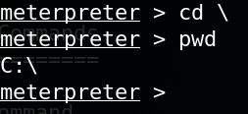
Find out the current directory where you landed in after penetration.
Go to the root of the directory in C: drive
The "\" should be this "/" instead because we are using linux shell...

Slide 22
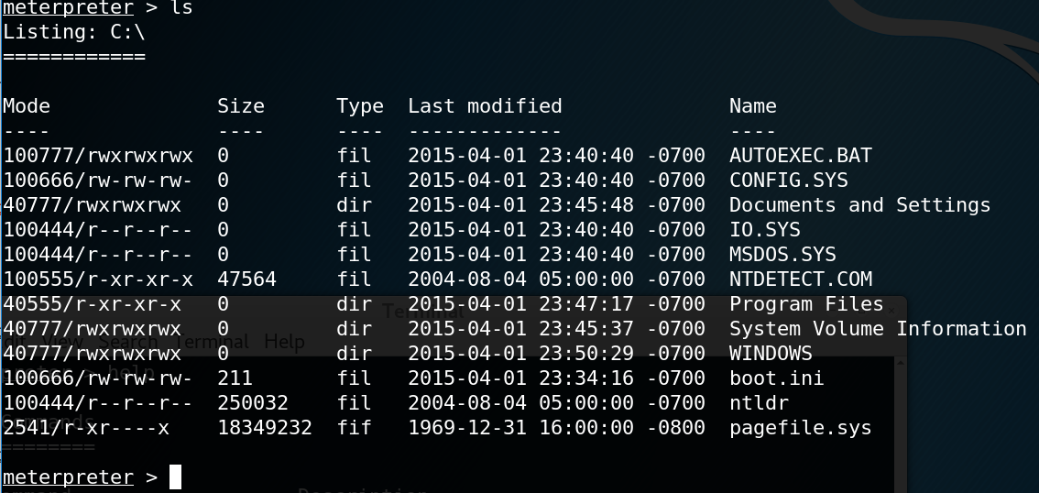
List out the folder and files of the root directory in C: drive

Slide 23
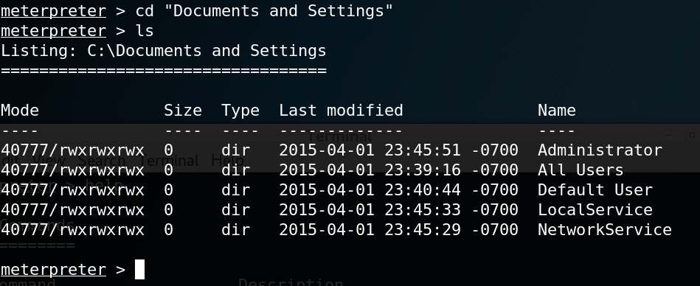
In Windows XP, the user directory are placed under the folder “Documents and Settings”, go to that directory and list out the users.

Slide 24
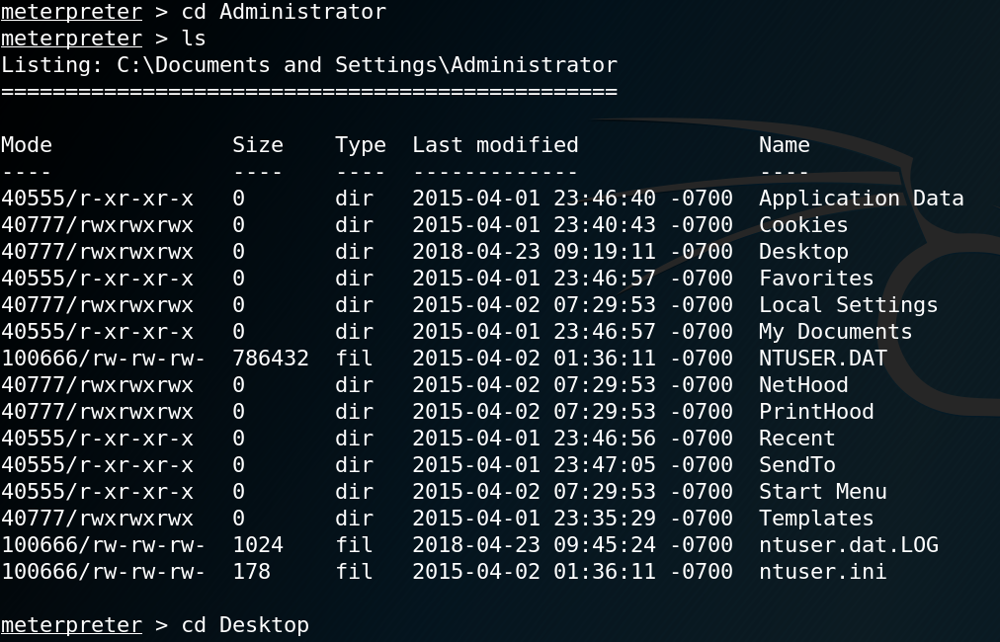
Step 8. To go to the Administrator’s Desktop, follow the commands on the left.

Slide 25
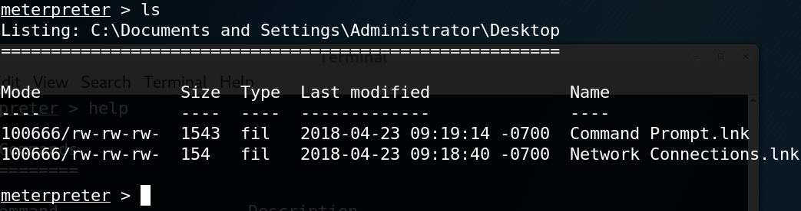
List out the contents on the Desktop.

Slide 26
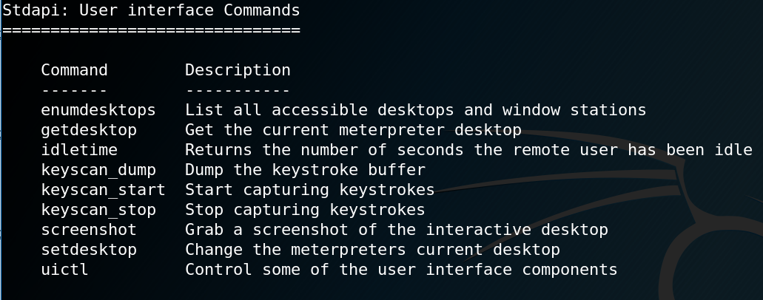
To prove that the Desktop’s listing is correct, we do a screen capture of the remote machine’s desktop (hopefully it is not blocked by any windows). We use help to find out the command that enable us to do that. Type help at the prompt…

Slide 27
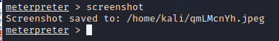
Type the command “screenshot” at the prompt.

Slide 28
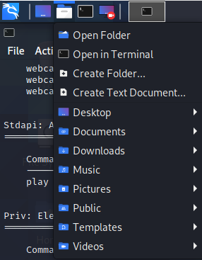
To view this image file, we use the file manager provided by Kali Linux. Click the icon to activate it.

Slide 29
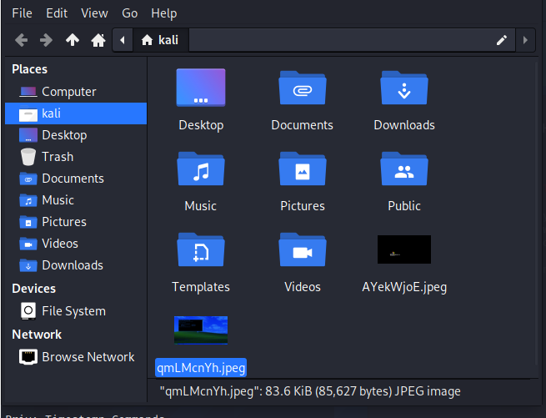
Step 13. Navigate to the root directory and you shall find the screen capture.

Slide 30
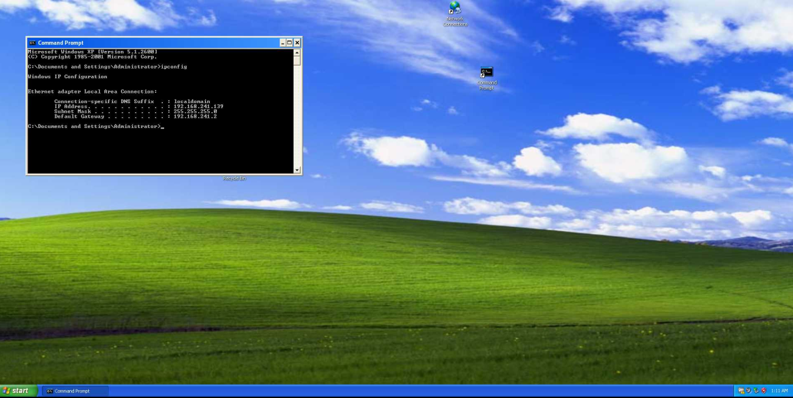
Double click on the image to see the contents on the Desktop of the remote machine:
--- End of Task 4 ---

Slide 31
Task 5 – Exploring the Exploited Machine using DOS’s commands

Slide 32
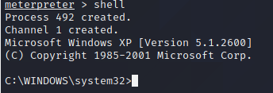
Task 4 – Exploring the Exploited Machine using DOS’s commands
Step 1 If you preferred to use command in DOS, type the “shell” command at the meterpreter prompt and you will get a DOS Shell.

Slide 33
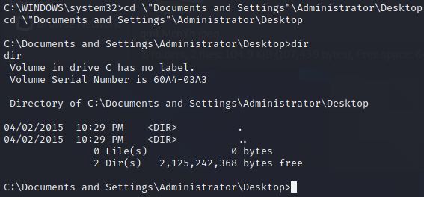
Now you are able to make use of the normal DOS command that you are more familiar. Type a DOS command to list out the file on the Desktop of the remote machine.

Slide 34
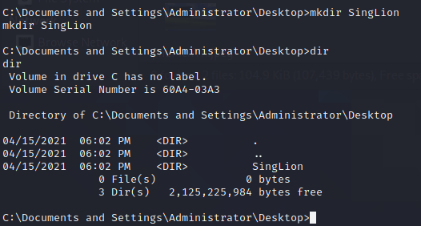
Make a temporary directory on the desktop and create a file in the Desktop. Show that the file you have created is there by list it out.

Slide 35
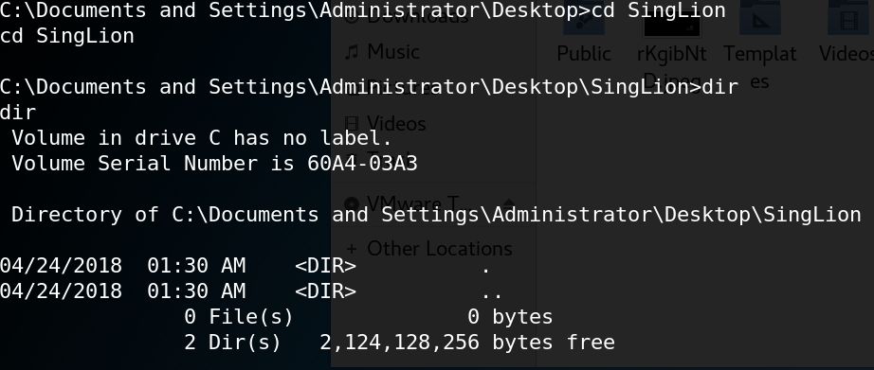
Go into the SingLion directory that you have created…

Slide 36
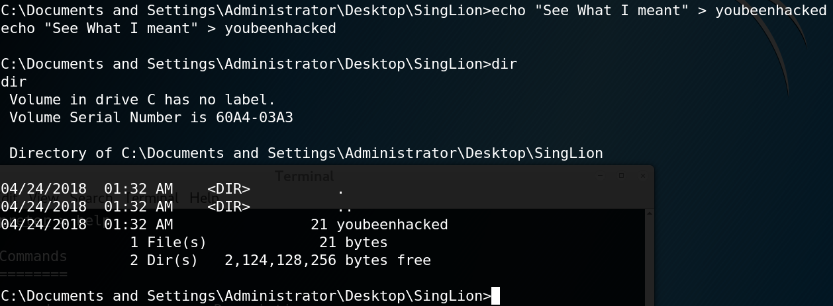
Create a file “youbeenhacked” ….

Slide 37
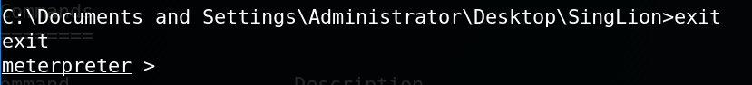
Exit the DOS Shell and return to the Meterpreter…

Slide 38
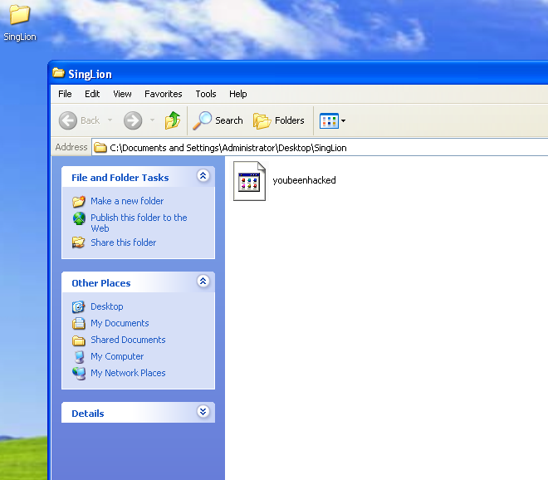
Turn to the XP VM to see the directory and file you have created.
--- End of Task 5 ---

Slide 39
Task 6 – Upload a file to the Remote Machine

Slide 40
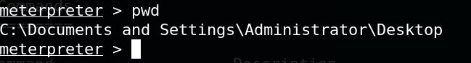
Task 6 – Upload a file to the Remote Machine
Check the current path at the remote machine…

Slide 41

Use the browser in Kali Linux, download a picture of yourself from anywhere.

Slide 42
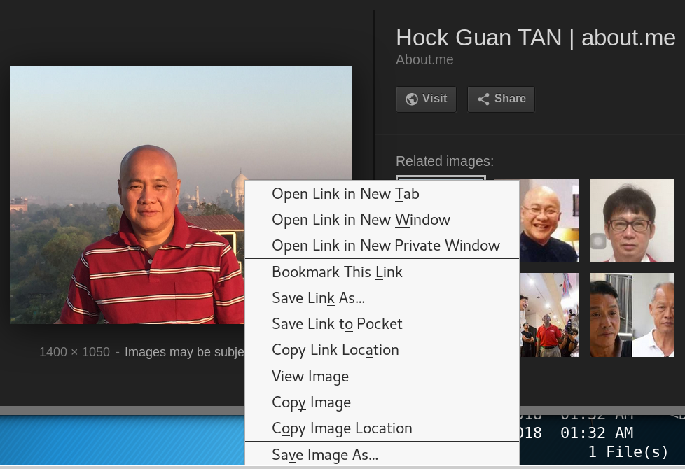

Slide 43
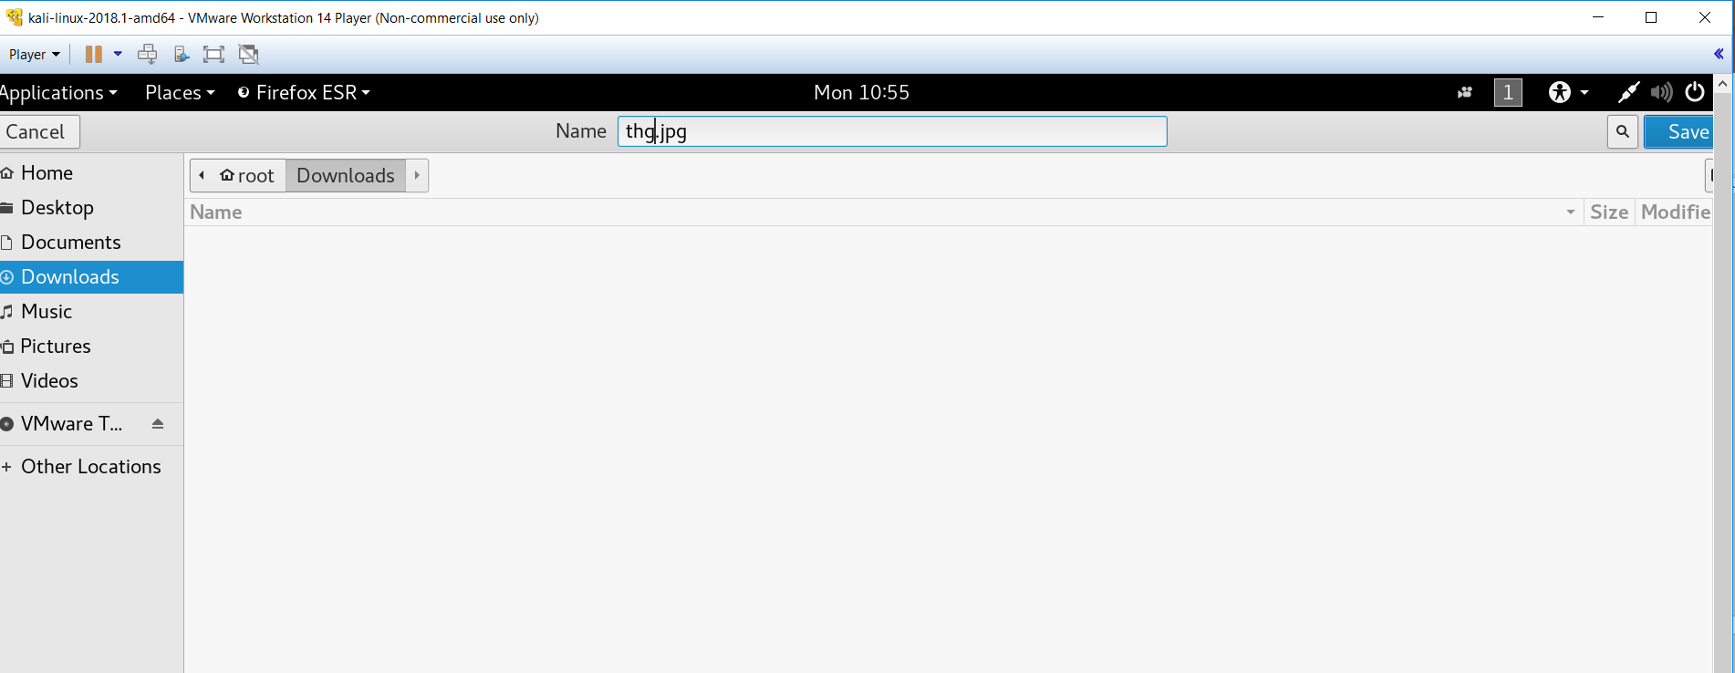
Take note where it save to.

Slide 44
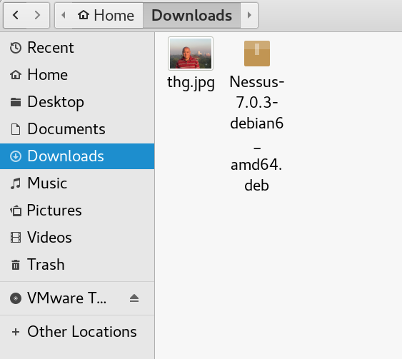

Slide 45
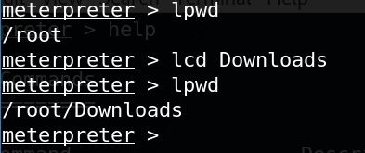
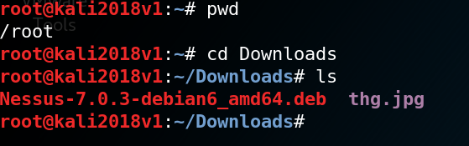
Go back to the meterpreter, change the directory to where the image is stored.
Open another terminal shell to check the contents of the Downloads folder if need to.

Slide 46
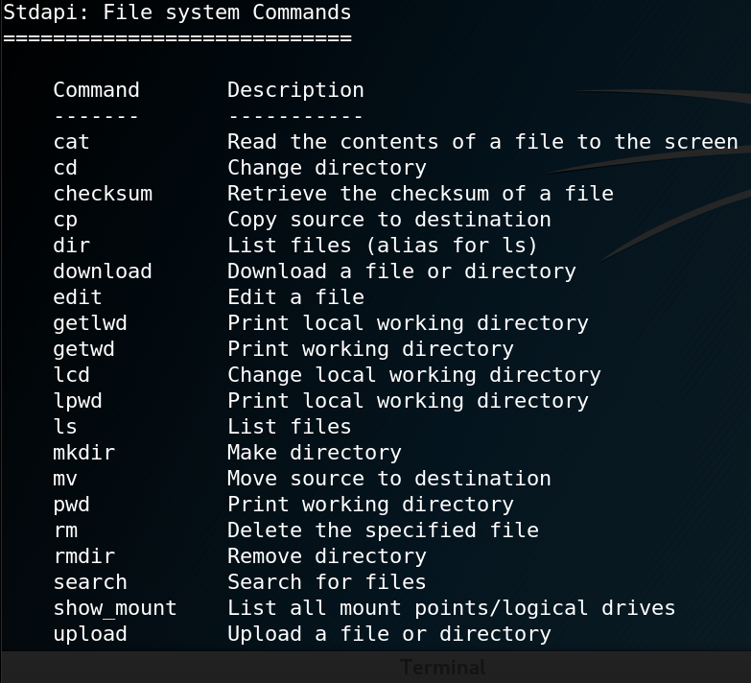

Slide 47
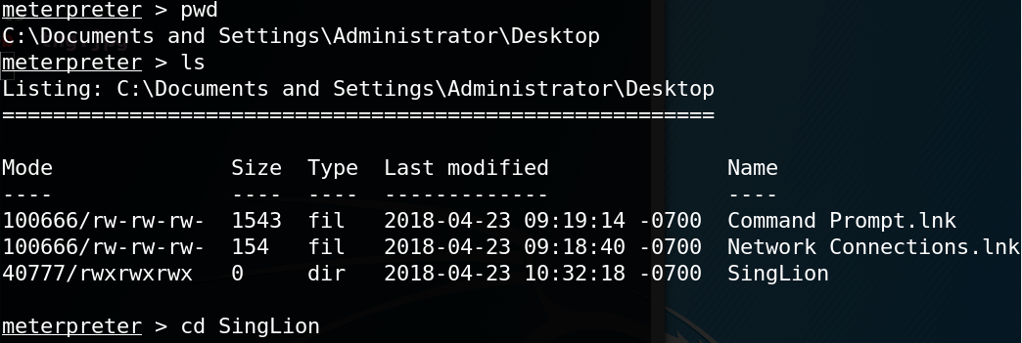
Upload the Image to the folder you have created on the Desktop of the remote machine.

Slide 48
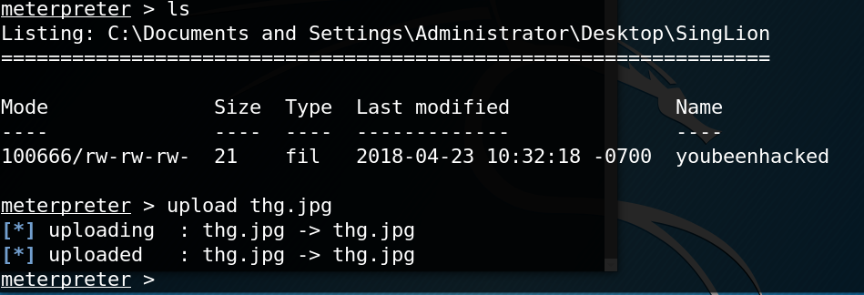

Slide 49
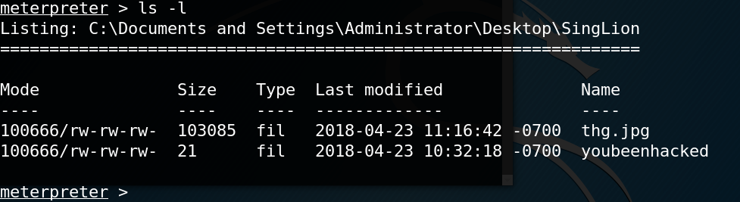

Slide 50
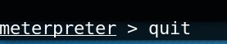
Step 6. Type “quit” to exit the meterpreter …

Slide 51
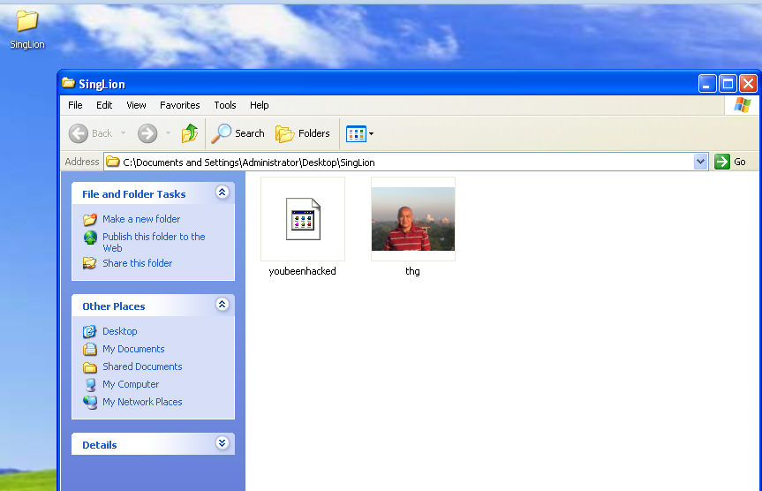
Go the Windows XP VM and check if the image has been uploaded.
--- End of Task 6 ---

Slide 52
Task 7 - Exploring other Payload available in Metasploit

Slide 53
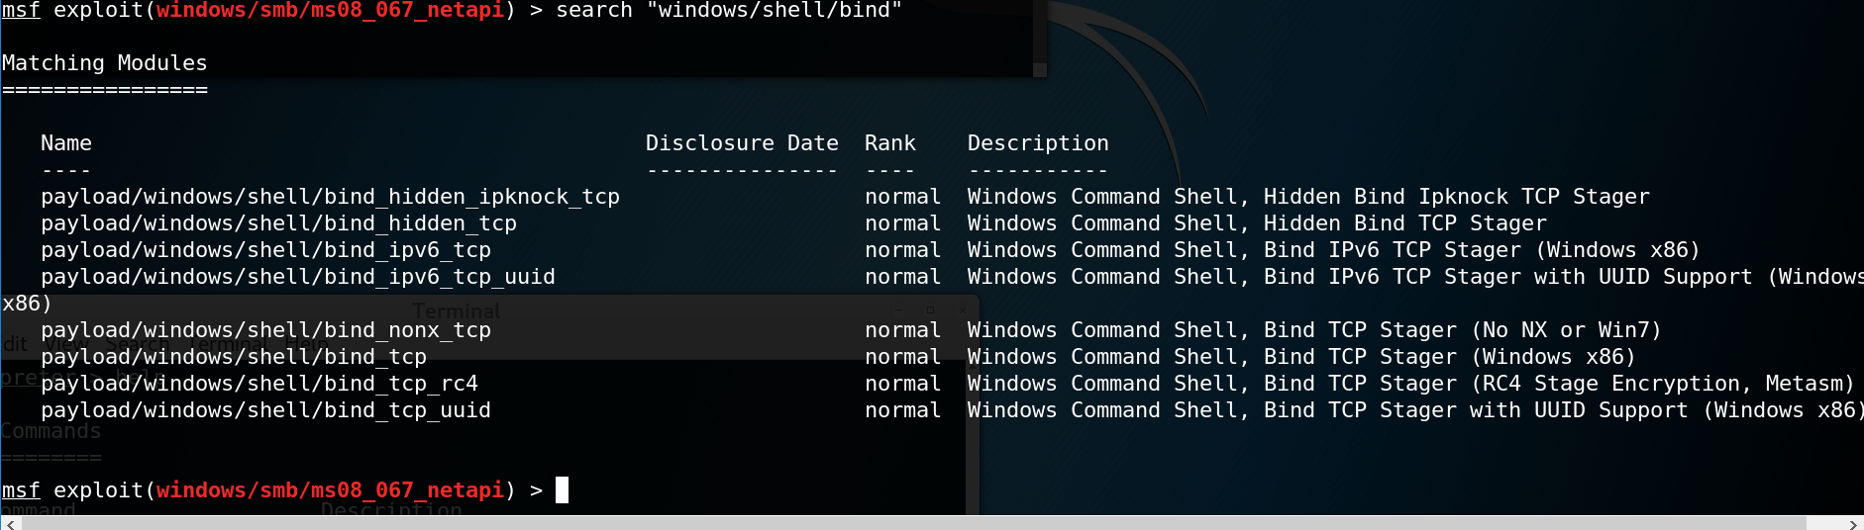
Task 7 - Exploring the Payload Available in Metasploit
Payload is the action that happens after the vulnerability is exploited. It is like choosing how you want to interact with the compromised target when the exploit is triggered successfully. Type the following command to search for payload that will return a “Windows Command Shell”.

Slide 54
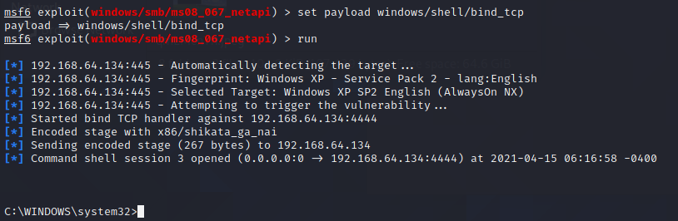
Set “windows/shell/bind_tcp” to penetrate into Windows XP.
Do you still get the Metepreter Shell ?
Press <ctrl><c> to terminate the session.
--- End of Task 7 ---

Slide 55
Challenge

Slide 56
Challenge 1.1
Research to find out what other Windows OS are affected by this MS08-067 vulnerability.
Download a copy the Windows Server 2003 VM in the Class Materials in 0421-EH-ALL, unzip and open it in your VM Player. You will not be given the Username and Password for this OS.
Set the Network Setting of this OS to NAT and use the same method to penetrate into the OS. Gather the evidences to show that you have penetrated into the OS.
Search for a secret.txt file and decode the message in the file.
Record your steps in a powerpoint and share with you peers in your classs's team, week 1 channel. Name your file as Cha1.1-your full name(Avoid using name not on your student card).

Slide 57
End

